Slide 1

Cyber Threat Emulation (CTE)
Module 2, Lesson 13:
Fuzzing
Notes:
This course assumes that there are specialized differences in CTE roles and responsibilities as defined by each branch of service.

Slide 2
Course Objectives
After completing this course, students will be able to:
Summarize the CTE squad's responsibilities, objectives, and deliverables from each CPT stage
Analyze threat information
Develop a Threat Emulation Plan (TEP)
Generate mitigative and preemptive recommendations for local defenders
Develop mission reporting
Conduct participative operations
Conduct reconnaissance
Analyze network logs for offensive and defensive measures
Notes:
Instructor Notes:
Course Objectives
After completing this course, students will be able to:
Summarize the CTE squad's responsibilities, objectives, and deliverables from each CPT stage
Analyze threat information
Develop a Threat Emulation Plan (TEP)
Generate mitigative and preemptive recommendations for local defenders
Develop mission reporting
Conduct participative operations
Conduct reconnaissance
Analyze network logs for offensive and defensive measures
Key Concept and Interactivity:
Reference Material:

Slide 3
Course Objectives (Continued)
Students will also be able to:
Analyze network traffic and tunneling protocols for offensive and defensive measures
Plan non-participative operations using commonly used tools, techniques and procedures (TTPs)
Notes:
Instructor Notes:
Course Objectives (Continued)
Students will also be able to:
Analyze network traffic and tunneling protocols for offensive and defensive measures
Plan non-participative operations using commonly used tools, techniques and procedures (TTPs)
Key Concept and Interactivity:
n/a
Reference Material:
n/a

Slide 4
Module 2: Threat Emulation (Objectives)
Conduct reconnaissance
Generate mission reports from non-participative operations
Plan a non-participative operation using social engineering
Plan a non-participative operation using Metasploit
Analyze network logs for offensive and defensive measures
Analyze network traffic and tunneling protocols for offensive and defensive measures
Plan a non-participative operation using Python
Develop fuzzing scripts
Develop buffer overflow exploits
Notes:
Instructor Notes:
Module 2: Threat Emulation (Objectives)
This module addresses how to...
Conduct reconnaissance
Generate mission reports from non-participative operations
Plan a non-participative operation using social engineering
Plan a non-participative operation using Metasploit
Analyze network logs for offensive and defensive measures
Analyze network traffic and tunneling protocols for offensive and defensive measures
Plan a non-participative operation using Python
Develop fuzzing scripts
Develop buffer overflow exploits
Key Concept and Interactivity:
n/a
Reference Material:
n/a

Slide 5
Module 2 – Lesson 13: Fuzzing (Objectives)
Define fuzzing
Explain the purpose of fuzzing
Identify the components of fuzzing
Perform manual fuzzing
Develop fuzzing scripts
Determine potential vulnerabilities
Use a third-party fuzzer to test an application
Notes:
Instructor Notes:
Module 2 – Lesson 13: Fuzzing
This lesson addresses how to…
Define fuzzing
Recognize fuzzing uses
Identify the components of fuzzing
Perform manual fuzzing
Develop fuzzing scripts
Determine potential vulnerabilities
Key Concept and Interactivity:
n/a
Reference Material:
n/a

Slide 6
Lesson Overview
In this lesson we will discuss:
Overflowing buffers
Manually
Simple Python scripts
Fuzzers
Developing your own fuzzer
Create your own simple network fuzzer with Python
Improve functionality and flexibility of your fuzzer
Preparing to conduct buffer overflow exploits
Notes:
Instructor Notes:
In this lesson we’ll discuss how to overflow buffers on simple, and vulnerable, network services/applications. We’ll then take that knowledge and expand upon that by creating fuzzers in Python. We’ll start off with simple scripts, move on to a simple fuzzer, and possibly a more flexible fuzzer.
Key Concept and Interactivity:
n/a
Reference Material:
n/a

Slide 7
What is Fuzzing
Owasp.org defines fuzzing as:
“…a Black Box software testing technique, which basically consists in finding implementation bugs using malformed/semi-malformed data injection in an automated fashion.”
- https://www.owasp.org/index.php/Fuzzing
Automated testing
“using malformed/semi-malformed data injection”
“random bad data”
“see what breaks”
IBM’s Elliotte Rusty Harold defines fuzzing as:
“In fuzz testing, you attack a program with random bad data (aka fuzz), then wait to see what breaks. The trick of fuzz testing is that it isn't logical: Rather than attempting to guess what data is likely to provoke a crash (as a human tester might do), an automated fuzz test simply throws as much random gibberish at a program as possible. ”
- https://www.ibm.com/developerworks/library/j-fuzztest/index.html
What are differences in these definitions? What is the difference between black box testing and white box testing?
Notes:
Instructor Notes:
Fuzzing has slightly different definitions depending on where you go. Most of them indicate automation as a key word. However, “manual fuzzing” is possible. More on that in the upcoming slides.
Fuzzing is an automated way of “poking” at a system/application in order to get it to fail.
Once a failure has occurred, we want to monitor it. More about this later in the module.
Fuzzing is black box by nature but is used during white box testing as well.
Similar in concept to brute forcing a password. If it is vulnerable, you’ll get it eventually.
Key Concept and Interactivity:
Key Concept: Fuzzing is an automated process of finding bugs in a system/software/etc.
Interactivity:
ASK, “What are differences in these definitions?” “Why?”
ASK, “What is the difference between black box testing and white box testing?”
DISCUSS, “Exceptions” such as crashes, failing, leaks, etc. at a high level. Detail covered later in this module.
Reference Material:
Fuzzing - OWASP
https://www.owasp.org/index.php/Fuzzing
Fuzzing – IBM
https://www.ibm.com/developerworks/library/j-fuzztest/index.html

Slide 8



Fuzzing Goals
Make stuff fall over…
Systematically providing inputs with the goal of making bad things happen
Looking for bad things:
Crashes
Hanging
“Use-after-free” discovery
Memory leaks
Unexpected behavior
Notes:
Instructor Notes:
Fuzzing has many goals but primarily we’re looking to cause errors, crashes, and other unexpected behavior.
Crashes: Straight forward, the target crashes and generally generates an error message (i.e., “This program has stopped working correctly.”).
Hanging: Exactly what it sounds like, the target hangs. It doesn’t crash, but it can’t progress either. Some people consider this a crash though it is beneficial to separate the two behaviors. Hard crashes (that produce exceptions) are often easier to exploit for remote arbitrary code execution. Hanging is more of a DoS event.
Use-after-free: Allows an attacker to use a section of memory after it has been freed. Exceptionally numerous and powerful in the browser world.
Memory leaks: Memory is incorrectly allocated and never released/freed properly. This can eventually cause a number of issues including performance degradation, crashes, or possible abuse by an attacker.
Unexpected behavior: Literally anything else that might happen. There have been some strange things found during fuzzing and not all are crashes. I’ve seen firewalls start passing all traffic, systems start to respond back with gibberish, sometimes an application will try to defend itself by attacking you, and in one case our fuzzer caused an electricity “smart” meter to catch fire. And if the students ask, yes…it was repeatable. The point here, is that “unexpected” really does need to be open ended.
Key Concept and Interactivity:
Interactivity:
DISCUSS IN DEPTH: What do we mean by “make stuff fall over”? Also, discuss examples of feeding an application/system input (i.e. command line inputs, file inputs, math/integer inputs, etc.)
DISCUSS: Any other potential outcomes? What is “unexpected behavior?”
Reference Material:
n/a

Slide 9


Why Fuzz?
Black box testing
Finds bugs in applications when you don’t have the source code
Most fuzzing is done in black box testing, but…
White box testing
Find bugs faster than just doing code review, cast wider net
Automation
Many aspects of fuzzing can be fully automated, freeing developers and analysts to focus on other aspects of the program/system
Notes:
Instructor Notes:
There are many reasons to fuzz and why you would choose fuzzing over (or in addition to) other types of testing. Adversaries who gain access to a system or application may not have source code, and they are left with full black box testing. In this case, fuzzing is one of the absolute best ways of identifying vulnerabilities.
But even if you do have a copy of the source code, white box fuzzing may still catch things analysts missed. Or, it may free up the time of team members to focus on other tasks while the fuzzing is being completed. This ties into the “automation” portion…
Fuzzing runs the gamut from complete manual testing to nearly full automation.
Key Concept and Interactivity:
n/a
Reference Material:
Difference between Black Box Testing and White Box Testing
https://www.softwaretestingclass.com/difference-between-black-box-testing-and-white-box-testing/

Slide 10

Basic Fuzzing Vectors
145713445
35373845101
Various attack vectors:
Text/characters
Numbers
Binary data
Metadata
HFOWFHPLWQPKZJHDWBCMWETJELPSIOLSW
10010101011
101101010
101010
So we have attack vectors, but how do we utilize them?
Notes:
Instructor Notes:
Text/characters: Generally command line options and variables, URLs, form data
Numbers: Regular numbers. But in the programming world we could be talking about integers or floats (decimals)
Binary data: Series of binary data. It may be pseudo random or it may make some sense, depending on the type of fuzzing you are doing
Metadata: Data about data. Directory structures, usernames, GPS coordinates, song name, song artist, author, and an infinite amount of other metadata that could exist
Key Concept and Interactivity:
DISCUSS: How would we utilize just the attack vectors listed here? Note for instructor, the next slide shows a more refined list of attack vectors.
Reference Material:
Fuzzing: Application Fuzzing
https://www.owasp.org/index.php/Fuzzing#Application_fuzzing

Slide 11
Basic Fuzzing Vectors – Improved
Known dangerous vectors:
Integers: zero, negative numbers, and very large numbers
Characters (chars): Escaped characters, interpretable (injection like attacks), odd symbols (¢ ≈ š?), or simply a large amount of characters
Binary: random ones
Notes:
Instructor Notes:
Each of the types of fuzzing vectors here are considered to have a higher than average chance of causing failures, so in many cases they should be tried first. Fuzzing tools generally utilize one or more of these vectors by default.
Not all vectors are made equally, some have a much higher chance of doing damage. The reference links below can be used to expand your knowledge on fuzzing vectors, including more advanced methods.
Key Concept and Interactivity:
n/a
Reference Material:
Fuzzing: Application Fuzzing
https://www.owasp.org/index.php/Fuzzing#Application_fuzzing
OWASP Testing Guide Appendix C: Fuzz Vectors
https://www.owasp.org/index.php/OWASP_Testing_Guide_Appendix_C:_Fuzz_Vectors

Slide 12
OWASP Fuzz Vectors
Recursive vs Replacive
Recursive
Sharing a trait with brute force, recursive fuzzing involves iterating through all possible combinations of a valid character or alphabet
Replacive
Fuzzing by replacing a known input with new data. This new data could be pseudo random or it could be known attack vectors.
e.g. Input: aaaa, Input: bbbb, Input: cccc, etc.
e.g. SQL injection, LDAP injection, etc.
Notes:
Instructor Notes:
Recursive and replacive are two high level categories of fuzzing. We’ll focus mostly on a modified recursive in this course (“modified’ meaning we won’t be testing every single input, but we’ll be increasing length and complexity until bad things happen).
Key Concept and Interactivity:
Interactivity:
DISCUSS: Recursive involves iterating on “every” possible input, but we can focus our testing on increasing length or complexity rather than just iterating 1 by 1.
Reference Material:
OWASP Testing Guide Appendix C: Fuzz Vectors
https://www.owasp.org/index.php/OWASP_Testing_Guide_Appendix_C:_Fuzz_Vectors

Slide 13
Fuzzing categories
Primary Types of Fuzzing
Generation
Mutation
Evolutionary
Have you heard of or used any of these types of fuzzing before?
Notes:
Instructor Notes:
We cover each of these in their own slide(s). But you are welcome to see if the students have heard of/used any of these before.
Key Concept and Interactivity:
Interactivity:
ASK: Have you heard of or used any of these types of fuzzing before?
Reference Materials:
15 Minute Guide to Fuzzing
https://www.mwrinfosecurity.com/our-thinking/15-minute-guide-to-fuzzing/

Slide 14
Generation Fuzzing
“Intelligent” or “smart” fuzzing
Generates input from scratch
Generates input based on user provided instructions
Knowledge of the system/application/protocol
Notes:
Instructor Notes:
Generation based fuzzing is considered “smart” because it is generally aware of and understands the file format or protocol that is being fuzzed. The fuzzer will then generate inputs that fit that general format.
Creating rules for generation based fuzzing can be time consuming but rewarding.
Key Concept and Interactivity:
n/a
Reference Material:
Infosec Institute: Fuzzing – Mutation vs. Generation
https://resources.infosecinstitute.com/fuzzing-mutation-vs-generation/#gref

Slide 15
Mutation Fuzzing
“Dumb fuzzers”
Modifies existing (real) input
Utilizes a corpus of seed input
i.e. If the application inputs text, provide a large amount of valid text. If the application analyzes images, provide a library of valid images.
Notes:
Instructor Notes:
Seed Corpus: “set of valid and interesting in puts that serve as starting points for a fuzz target” - https://chromium.googlesource.com/chromium/src/+/master/testing/libfuzzer/efficient_fuzzer.md
Radamsa is a well known mutational input generator. Students may decide to use this during the intermediate fuzzer lab.
zzuf is another powerful tool for mutation based fuzzing. It can be used to mutate a specific percentage of an input or the entire thing.
Key Concept and Interactivity:
n/a
Reference Material:
Infosec Institute: Fuzzing – Mutation vs. Generation
https://resources.infosecinstitute.com/fuzzing-mutation-vs-generation/#gref

Slide 16
Other Types of Fuzzers
Evolutionary
Monitors behavior and responses and generates test cases based on those observations
Context-free, Grammar-based Generation
Generation-based fuzzer that utilizes expressions, terms, operations, factors and constants
Taint-based Directed
“Whitebox” fuzzing that is aware of possible vulnerable points and focuses testing at those points.
Arguably one of the most useful styles of fuzzing currently available
Notes:
Instructor Notes:
These fuzzer types will not be utilized in this course as they are a lot more complex. However, students should be aware of their existence as they are extremely powerful and provide alternate ways of potentially fuzzing a target.
Key Concept and Interactivity:
n/a
Reference Material:
Great resource for grammar based introduction:
How does grammar-based test case generation work?
https://www.veracode.com/blog/managing-appsec/how-does-grammar-based-test-case-generation-work
Far less real world documentation about taint-based.
Evolutionary seems to be a combination of any type, with the focus on adapting test cases based on the observations of old test cases.

Slide 17
Catching the Results
Simply fuzzing isn’t enough on its own, we need to monitor the results:
Monitor for exceptions
One of the most common results from fuzzing are crashes and other exceptions
Utilize debuggers
Can hook a process and help pinpoint where an exception occurred
Monitor responses
Various methods ranging from watching the screen to advanced scripts and even hardware devices
Notes:
Instructor Notes:
We need to monitor the results, regardless of the format. It can be as simple as watching the screen. Take for example, an application being fuzzed. Upon sending that application 1 billion letter A’s you see a message that “This application has stopped working correctly.” While you haven’t pinpointed the exact issue, you’ve almost certainly found yourself a buffer (or similar) overflow.
Adding debuggers to the mix allows us to closely monitor what is happening in memory during the fuzzing tests. And if any exception occurs, we can pinpoint its location in memory. NOTE: We will be doing this during our exercises. IMPORTANT: We can only use a debugger, if we have access to the application/system running. We cannot hook a debugger into a remote web service.
Some applications/systems provide responses. Occasionally these responses provide the tester with more information. Take for example a program that simply adds two numbers together, and then provides the results to the screen. Upon sending it special characters you may receive an exception, or perhaps a unique response.
The more exceptions or odd behavior/responses collected, the better. In some cases (like our exercise) we will focus on one or two specific crashes. But often times real exploits are found after sifting through thousands upon thousands of exceptions, caught in a special monitoring environment.
Key Concept and Interactivity:
n/a
Reference Material:
Fuzzer Implementations
https://www.owasp.org/index.php/Fuzzing#Fuzzer_implementations

Slide 18
Let’s find a buffer overflow: Initial Setup
Open your Lesson 13 environment which will include:
Windows 7
Kali Linux
Take note of the IP address for each
Ping each machine from the other to verify connectivity and firewall status
This is a network based example, so firewalls need to be off.
Notes:
Instructor Notes:
Direction of this course is there are no instructor-led exercises. However, if students wish to follow along it should be fairly easy to keep pace.
Key Concept and Interactivity:
Interactivity: This is the beginning of a “follow the leader” style exercise. Guide the students through each step as it appears on the slide. Some students may need 1-on-1 help with some parts of this exercise.
VERIFY with the students that the Windows firewall is off and that the two systems can ping each other in both directions. Have them do this. Connectivity issues could cause a lot of grief later on if they aren’t aware a firewall is stopping communications.
Reference Materials:
n/a

Slide 19
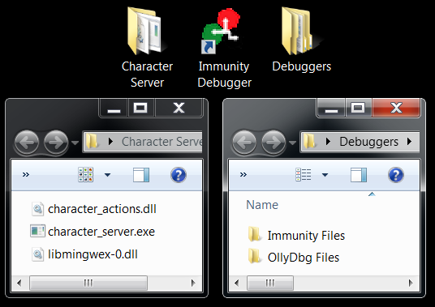
Important Files and Directories
On Windows 7 we will be working with a program called “Character Server” and debuggers, specifically Immunity (Optionally OllyDbg)
Have you ever used OllyDbg or Immunity Debugger?
When, why, how?
Notes:
Instructor Notes:
“Character Server” is a highly vulnerable application. It is okay to tell students this, but do not reveal the original name (even if you know it). Doing so will lead them to tons of tutorials on exactly how to crack this software.
If the students ask, the DLL’s are required for the server to function.
Key Concept and Interactivity:
Interactivity:
Inform the students that their desktops may not look exactly like the screenshot, but they should have these files/directories on their desktop somewhere.
ASK the students if they’ve ever used OllyDbg or Immunity Debugger before? If so, when/why/how/etc.?
Reference Materials:
n/a

Slide 20
“Character Server”
SCENARIO: You’ve discovered that your target is using a piece of software called “Character Server.” You have obtained a copy of the executables and DLL’s but not the source code. You are not able to identify any open source information about this application, its uses, or its vulnerabilities.
TASK: Identify vulnerabilities through simple fuzzing.
Notes:
Instructor Notes:
SCENARIO: You’ve discovered that your target is using a piece of software called “Character Server.” You have obtained a copy of the executables and DLL’s but not the source code. You are not able to identify any open source information about this application, its uses, or its vulnerabilities.
HINT: Any references to “Character Server” found online are completely coincidental. This is a modified program specifically designed for this class. Don’t chase the white rabbit too far…
TASK: Identify vulnerabilities through simple fuzzing.
Key Concept and Interactivity:
n/a
Reference Material:
n/a

Slide 21
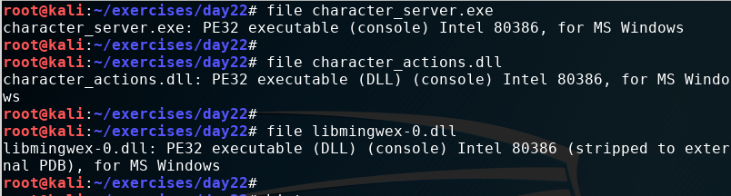
What type of file is this anyways?
Character Server is made up of 1 EXE file and 2 DLL files according to the directory. But it is often prudent to check the header info to be sure.
What do you notice about…
PE32 Intel 80386?
The console vs DLL?
Notes:
Instructor Notes:
The files are as they seem. It is a 32 bit EXE and two DLL’s, each has functions that the EXE will utilize. A copy of them exist on the Windows 7 desktop in a folder called “Character Server” and each of the three files have been included directly on the desktop of root@kali.
From root’s desktop, perform the following commands:
File ‘/root/exercises/day22/character_server.exe’
File ‘/root/exercises/day22/character_actions.dll’
File ‘/root/exercises/day22/libmingwex-0.dll’
Key Concept and Interactivity:
Interactivity:
ASK the students if they notice anything about this other than the fact that it is a MS Windows executable.
What about PE32 Intel 80386? ANSWER: 32bit Portable Executable (not actually portable though)
What about the (console) vs (DLL)? ANSWER: DLL is a DLL, console is command line, (GUI) would indicate a graphical window program.
NOTE: We’re using our Kali box here to determine what type of files these are. This is not the only way….
Reference Material:
n/a

Slide 22
Setting up something to fuzz
character_server.exe:
PE32 executable (console) Intel 80386, for MS Windows
Now that we know what type of files these are, how would we run them?
Notes:
Instructor Notes:
character_server.exe: PE32 executable (console) Intel 80386, for MS Windows
Key Concept and Interactivity:
Interactivity:
DISCUSS: It appears to be a 32bit PE (console) so we should run it on a Windows system that supports 32 bit and we should run it in the console (CMD, Command Prompt, sometimes PowerShell but not for this module). It will also run with a double click or the ‘start’ command. DLL’s will not run on their own. In this case, the EXE needs both DLL’s to run properly. You can have the students experiment with moving the DLL’s (either both or one at a time) into a new folder and trying to run the executable.
Reference Material:
n/a

Slide 23
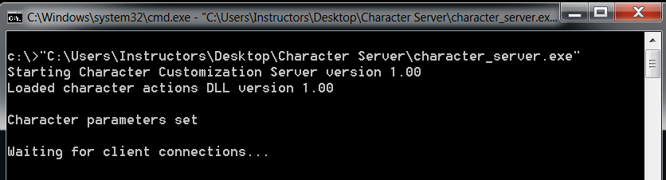
Running the server to be tested
Because it is a Windows console program, let’s run it on our Windows box
What can we tell about the program so far?
Notes:
Instructor Notes:
The server starts easily. We are NOT running as an Administrator now but that may be useful eventually. SECRET: The versions and info here are all fake.
Key Concept and Interactivity:
Interactivity:
ASK the students to discuss what they are observing here. Things that should be discussed (let the students lead this, but add if necessary):
version numbers are 1.00, seems like a new program, possibly not matured.
Waiting for client connections…
if this is to be believed, it means the program is in a listening statement. ASK the students how we can determine if it is listening and on what port? Answer on next slide.
Reference Material:
n/a

Slide 24
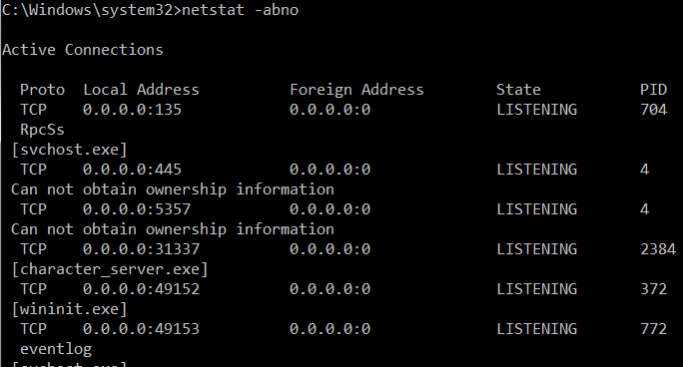
Determining server network behavior
Looks like the server is listening for connections on the network, let’s see what port it is using.
What do we do next?
Is this application listening on a port?
Notes:
Instructor Notes:
Netstat –abno will give you each process and the PID/name of each, in addition to all of the ports. However, it requires elevated (administrator) privileges. Students will have to open CMD in admin mode.
Key Concept and Interactivity:
Interactivity:
EXPLAIN that netstat –abno requires elevation to admin. However, without admin this can be done still. How? ANSWER: You sometimes don’t need admin to do a netstat –ano and then compare against a tasklist.
ASK “So, is this application listening on a port?” ANSWER: Yes, it’s on TCP 31337 but it is difficult to read the output at first. And yes, 31337 is ELITE.
ASK the “Now what?” question. We know the application is listening on port 31337, what can we do next? ANSWER: More than one answer, but for simplicity we could scan it or try to connect to it raw, just to see what I does…On the next slide I’m going to use AMAP, a great way of initially gathering more information on an open port.
Reference Material:
n/a

Slide 25
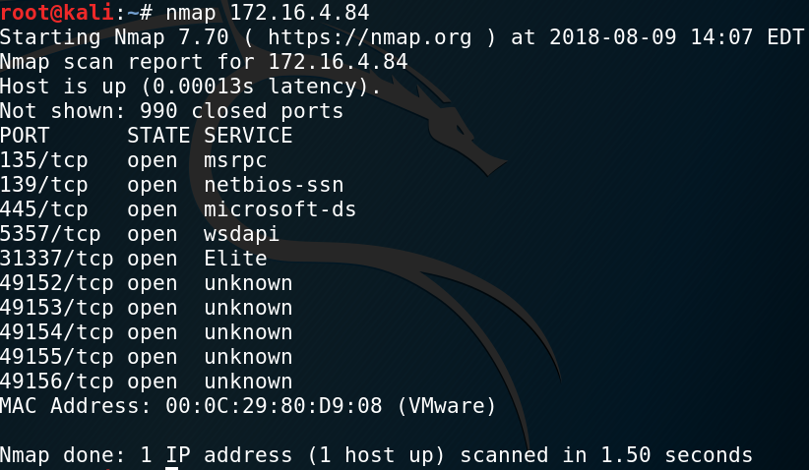
What’s happening on that port?
Various tools to help you interrogate an open port
Nmap
Amap
Netcat
Many more…
Notes:
Instructor Notes:
We noticed that the program appeared to open a port, 31337. A quick NMAP scan of that system shows us that 31337 is open and the service is listed as “Elite”, an unregistered port commonly used by hackers, programmers, and others that with to spell out elite in 1337 speak.
Key Concept and Interactivity:
Interactivity:
DISCUSS what NMAP found for us here. ANSWER: Not much more than we already knew, and the port information is fairly generic. Also, we could dig deeper with NMAP plugins, but that’s beyond the scope of this module.
Reference Material:
n/a

Slide 26
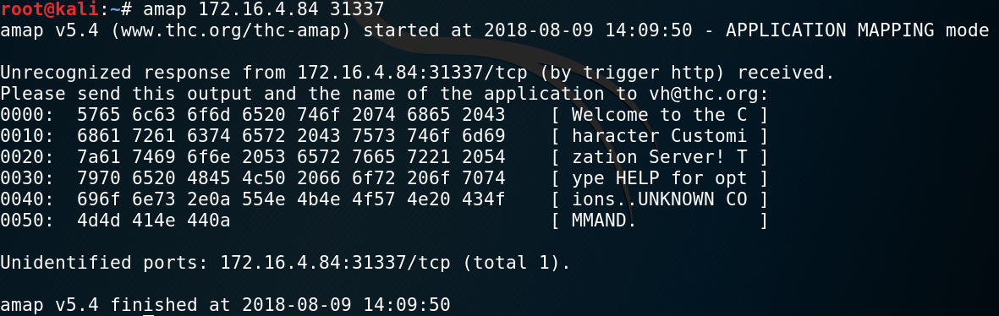
Digging deeper with Amap
How do we dive deeper?
Did AMAP help us identify what’s on that port?
If so, what?
Amap is an Application MAPper
Deeper dive than some other tools
Notes:
Instructor Notes:
AMAP is an application mapper. It does more banner grabbing type scans than nmap. It can also read raw protocols so even if it isn’t text, we can visualize what’s there.
Key Concept and Interactivity:
Interactivity:
ASK “Did AMAP help us identify what’s on that port? If so, what?” ANSWER: Yes, looks like some sort of “character customization server” and it says “Type HELP for options” indicating this might be an interactive console application.
ASK “Okay, since this appears to be an interactive console, how do we dive even deeper?” ANSWER: nc (netcat) to it and start poking at the application. Shown in next slide.
Reference Material:
n/a

Slide 27
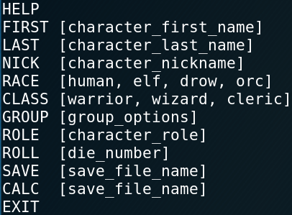
Let’s connect and find more
Using netcat we can establish a raw connection to this port/service
Pretty obvious here isn’t it? Type HELP
What is this? What should we do next?
Notes:
Instructor Notes:
Netcat is a raw socket tool. It can be used for a wide variety of connections and testing. Nicknamed the “network administrators Swiss Army knife.”
Key Concept and Interactivity:
Interactivity:
ASK “What is this? What should we do next?” ANSWER: Lots of answers here. Some may know this as a character customization for a game or tabletop roleplaying game. Understanding the programs purpose doesn’t matter to us that much though. What we care about, for fuzzing purposes, what are the inputs? Seems it is COMMAND + <text>
Reference Material:
The GNU Netcat Project
http://netcat.sourceforge.net/

Slide 28
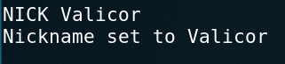
It accepts input
Seems at least one of these commands accepts text input:
What can we do to try and fuzz this manually?
Notes:
Instructor Notes:
These commands all accept some sort of input and most have an output. This is where fuzzing comes in. Time to throw some fuzz at the server and see what falls down.
Key Concept and Interactivity:
Interactivity:
INFORM the class that for the slides we’re only going to focus on the “NICK” command, but they will have their time to try another command on their own.
ASK “What can we do to try and fuzz this manually?” ANSWER: Lots of tricks for fuzzing. But at a VERY simple level, just throw a bunch of characters into it. Sometimes I’ll copy a wiki page or some Shakespeare in there. It’s not very real world, but for a lot of these low hanging fruit buffer overflows, it does the trick.
Reference Material:
n/a

Slide 29
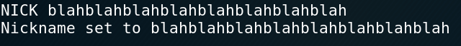
Can we overflow the buffer?
Let’s throw some characters in there and see…
Let’s check the server and see if we have any errors. Nope, let’s try more…
Okay, this is going to take a while.
What can we do to help test for overflows?
Notes:
Instructor Notes:
There is an argument whether this type of testing is really “fuzzing” or not. Regardless, it shows the students the basic concept of throwing “random” characters or input into a field and hoping it breaks something. Since these are all seemingly text fields we’re working with, that’s why we try the blahblah’s here first.
Key Concept and Interactivity:
Interactivity:
ASK “So, what can we do to help test for overflows?” ANSWER: The obvious answer here is fuzzing. If a student recommends a pre-established fuzzer that could work great, but with a program like this (custom) we may want to use Python and create our own. Next slide starts that process.
Reference Material:
n/a

Slide 30
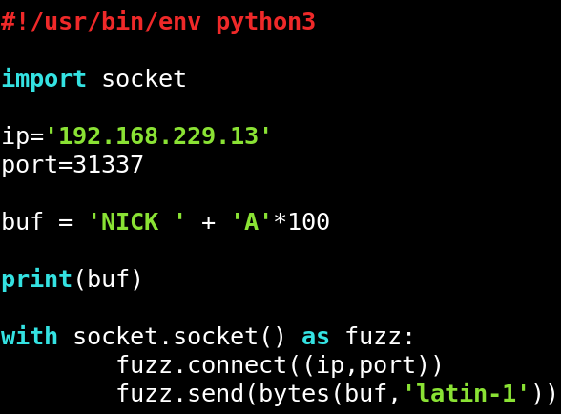
Python to the rescue
We have the option of typing “random” characters for days, but let’s use Python to automate the task for us.
shebang
import
variables
buffer
debug test
context manager
send it
Notes:
Instructor Notes:
So we’re using Python to send a command and a string of characters with the goal of overflowing a buffer.
shebang: (Usually pronounced sha-bang or shuh-bang), it’s the #! and it specifies which interpreter should be used. In our case, the default Python instance in our system.
import: Gains access to another module, in this case socket. Socket provides functions for connecting to, sending, and receiving data from raw sockets.
variables: Straightforward variables. We’re declaring them here as our target IP and known port. HINT: Students may want to make this dynamic later in the module.
buffer: The name is not important here, it could be anything. The idea is that anything in the “buf” variable is eventually getting sent to the target. This is our fuzz. In this example we’re sending the letter ‘A’ times 100, so that’s 100 letter As.
debug test: By printing ‘buf’ here we can visually see what should be getting sent over the socket.
send it: fuzz is another custom variable, and can be anything students want. This block of code uses functions from the import socket to establish a raw TCP connection with the (ip, port) and then send the (buf).
fuzz.connect((ip,port)) = establishes the socket
fuzz.send(bytes(buf, ’latin-1’)) = we are sending the info via bytes because that is how python3 communicates. The latin-1 is the encoding that will be used. Latin-1 is compatible with various encoding methods to include ASCII. This will help in making a successful connection.
Key Concept and Interactivity:
Interactivity:
DISCUSS with the students each part of this, what it does for us, why we used it.
EXPLAIN that there are infinite ways of doing this, this is a simple example.
Reference Material:
https://docs.python.org/3.4/howto/unicode.html

Slide 31
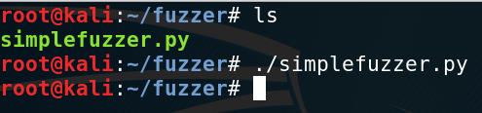
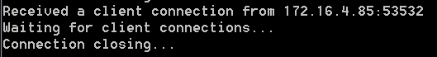
Does it work?
Let’s run it against the application and see if anything falls over.
Notes:
Instructor Notes:
We called our fuzzer simplefuzzer.py
Remember to do a chmod +x to make it executable if it isn’t already.
Also, the “victim” system needs to be running and the application ready and listening.
Key Concept and Interactivity:
Interactivity:
DISCUSS what happened. Fuzzer established a connection, and closed it, but nothing crashed.
ASK “What can we try next?” ANSWER: Increase the length of the buffer. 100 characters isn’t that much after all, not for modern computers.
Reference Material:
n/a

Slide 32
We can definitely do it this time
Let’s increase the buffer size slightly…
Notes:
Instructor Notes:
One of the benefits of using a variable for the buffer is that we can do things like this. Change one number and the entire buffer increases/changes.
Key Concept and Interactivity:
Interactivity:
DISCUSS: We went from 100 to 100 million. Is this efficient? ANSWER: Of course not, but it highlights the need for systematic testing, which we’ll do in a few slides.

Slide 33
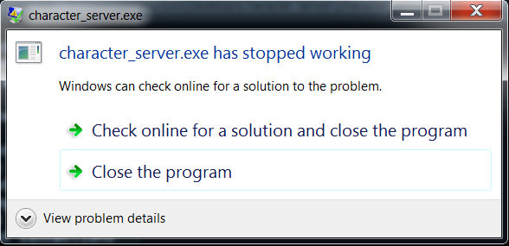
It fell over
Looks like 100 million A’s will work
Notes:
Instructor Notes:
100 million A’s will do it. So will 110, but the students don’t know this yet. The next concept is to systematically increase from a starting point (we’ll use 1 letter A) until it falls over or we get bored.
Key Concept and Interactivity:
Interactivity:
DISCUSS: We found a probable overflow! Somewhere between 100 A’s and 100 million A’s we have a buffer overflow?
ASK: What do we do next? ANSWER: Several good answers, the one we are looking for is to step up the number of A’s until we narrow down roughly how many A’s it takes. This is the beginning of what fuzzing is really about.
DISCUSS: Running the script this time took several seconds before the remote program crashed. Why? ANSWER: It was actually the print debug test that took time to calculate. The second that the buf actually got sent, the remote program crashed.
Reference Material:
n/a

Slide 34
Catching the results, a better way
We’ve seen a crash in Windows, now let’s try a debugger (Immunity)
Multiple ways to hook a process
Drag and drop executable onto debugger icon
Open debugger, then File > Open
Open debugger, launch application, then File > Attach
Notes:
Instructor Notes:
Immunity and other debuggers generally have multiple ways of hooking a process. Essentially you either open the process with the debugger or you hook (attach) to an existing process on the system. This works similarly whether in Windows or *NIX.
Key Concept and Interactivity:
Interactivity:
DISCUSS: When might you need the ability to hook/attach to an existing process rather than just opening an executable? POSSIBLE ANSWERS: You have access to the system but not the executable. The process in question is running entirely in memory. Perhaps it is malware running in memory that you wish to analyze. Analyzing a live service to check if it is vulnerable.
Reference Material:
n/a

Slide 35
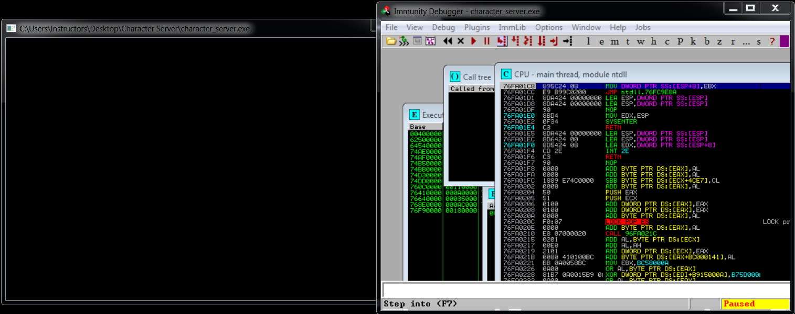
Attaching or opening the process
We decided to open the executable in Immunity with File > Open
Notes:
Instructor Notes:
This is the students first look at Immunity. They’ll see it more in the buffer overflow module.
Key Concept and Interactivity:
Interactivity:
ASK: There is lots of important information on this screenshot, but is there anything of higher importance? ANSWER: Bottom right has “Paused” which indicates the process is hooked but not currently running. This is standard when opening new processes. To get by this, we have to hit a button or two. The simplest way is to hit the > Play button (actually a ‘Run’ button, F9 is shortcut) until the status changes to “Running” NOTE: Advanced students may recommend various key bindings or options such as “Run till Return.” While these are great suggestions, the play button is generally the easiest for beginners to learn.
Reference Material:
n/a

Slide 36
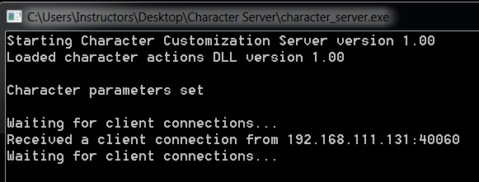
Now, let’s try again with the debugger
Run the script again, and check the results in Immunity
Notes:
Instructor Notes:
The Immunity debugger should now be in the “Paused” state again. The client software appears to still be running as normal. That’s because the debugger has paused the process prior to the crash. We don’t cover registers in this course much, but we will cover a few key registers during the next module when we build a buffer overflow POC and exploit. For now though, note that the ESI register is full of ASCII A’s. If students want to try this, they can throw different letters in there and should be able to see that letter in one of the registers (likely ESI).
Key Concept and Interactivity:
Interactivity:
DISCUSS: The character server appears to still be running, but there is an Access violation and it says “Paused”. This is what it looks like when Immunity catches an exception. The program freezes just before the crash.
Reference Material:
n/a

Slide 37
Why’d we just do that?
Goal of fuzzing?
Make something fall over
Crashes are only the first step
Monitoring results is critical
What’s next?
Turn crashes into exploits!
Notes:
Instructor Notes:
This is intended to be a review slide. The bullets are intended to help guide a conversation with students.
Remember the first goal of fuzzing: Make something fall over
Crashes don’t automatically make something vulnerable to attack. But it is a first step. We’ve discovered a crash (or more) here today, now we need to streamline that.
Monitoring the results is critical, regardless of how you do it. Remember, fuzzing without monitoring is pointless. It only makes sense if you are able to observe what type of behavior is happening.
Eventually you’ll want to turn your crashes into exploits. This is covered in the next module.
Key Concept and Interactivity:
Interactivity:
DISCUSS: Summarize slide, open the class up to review of the walkthrough as well as any questions.
Reference Materials:
n/a

Slide 38

An example of 3rd party fuzzer
Sometimes, it’s just easier/faster to use a 3rd party tool…
SPIKE (one of those 3rd party fuzzers)
Well known, poorly documented
Scalable
Allows custom C programming
Notes:
Instructor Notes:
We’ll be walking the students through basic SPIKE usage. SPIKE is a well known, but very poorly documented, fuzzer that is built into Kali. It is not even close to the best fuzzer out there, but it serves our purpose for this class perfectly. This may be a good time to explain that we will only scratch the surface of 3rd party fuzzers. This is an example of how to use one, not a comprehensive guide.
The custom C programming allows for extensive flexibility and scalability.
Key Concept and Interactivity:
Key Concept: Introduce SPIKE.
Reference Materials:
An Introduction to Fuzzing: Using fuzzers (SPIKE) to find vulnerabilities
https://resources.infosecinstitute.com/intro-to-fuzzing/#gref

Slide 39
SPIKE Commands
SPIKE provides a framework for customized fuzzing scripts and commands to execute them. Here are some of those commands:
Challenge: Briefly research the commands above. What can you find?
Notes:
Instructor Notes:
We’ll mostly be focused on generic_send_tcp which allows raw TCP sockets to be created and data send/recv.
Key Concept and Interactivity:
Interactivity:
[CLICK THROUGH to display the challenge description.]
CHALLENGE: Have the students try to research (for a few minutes only) each of these. They will find loads of good information, but also run into the lack of documentation for some, like generic_chunked. The point is, SPIKE is a powerful tool but is designed for programmers and vulnerability analysts who already know what they are doing.
generic_chunked – (poorly documented) Based on what little documentation exists, it appears this is for sending generation based fuzzing “chunks” of arbitrary data.
generic_listen_tcp – (poorly documented) Listens for incoming connections and then attempts to fuzz the client connecting.
generic_send_tcp – Better documented and the primary SPIKE tool. This is used to establish raw socket connections (via TCP) and send fuzzing data to a remote server. Useful for many types of servers, and our choice for this class
generic_send_udp – Similar to the send_tcp, but obviously using UDP instead. Very good for any UDP service, including some streaming services, voip, gaming, etc.
generic_web_server_fuzz(2) – Poorly documented, and cannot find a reason for two versions. But in general, this is used when attempt to fuzz GETs, POSTs, and other web interactions.
Reference Materials:
An Introduction to Fuzzing: Using fuzzers (SPIKE) to find vulnerabilities
https://resources.infosecinstitute.com/intro-to-fuzzing/#gref

Slide 40
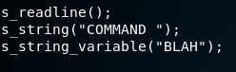
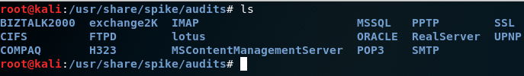
SPIKE Scripts
SPIKE scripts provide the framework for customized C code fuzzers.
Example (simple) script:
Or, pre-configured scripts:
Notes:
Instructor Notes:
SPIKE scripts provide the framework for customized C code fuzzers.
s_readline(); - Reads a single line from the server response (useful for seeing what is happening
s_string(“COMMAND “); - Sends this string at the beginning of EVERY fuzz attempt. In our case “COMMAND” will be replaced with whatever Character Server command the student wants to fuzz.
s_string_variable(“BLAH”); - This string is sent first along with the s_string. If you have a variable that you want to test, you can put it here. I like to include something unique (easily searchable) here. For our purposes, a complex 5000 character string or just the word “BLAH” is good enough.
Pre-configured scripts are a great resource. Even if you can’t find the script you need, you can use them for format and ideas from other scripts that have already been created. By default, Kali Linux stores these scripts in /usr/share/spike/audits.
Key Concept and Interactivity:
Interactivity:
ASK: How might we edit this for our purpose? ANSWER: Change the “COMMAND” to one of our commands, like NICK or GROUP or any of the others.
DISCUSS: How could we use pre-configured scripts if they don’t perfectly align to what we need. Instructor can also cat out a few scripts to show students here.
Reference Materials:
An Introduction to Fuzzing: Using fuzzers (SPIKE) to find vulnerabilities
https://resources.infosecinstitute.com/intro-to-fuzzing/#gref

Slide 41
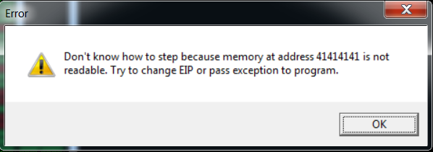
Capturing SPIKE Results
SPIKE is a very fast fuzzer that sends tons of data. So how do we know if it worked?
Capturing the data:
Attach target process to debugger
Open Wireshark and configure it to monitor all fuzzing attempts
Try to step through (F7) and see if EIP is corrupted
EIP: Extended Instruction Pointer – tells the system the address of the next command to be executed
Notes:
Instructor Notes:
We’ve already covered attaching to a debugger; it is a critical task here. Setting up Wireshark should be something the students have already done. Nothing fancy needed, just capture the traffic. Capture filters can be used if desired (such as destination IP).
Stepping through (or attempting to) is something we haven’t discussed before. This is done in the debugger AFTER a crash. When you press F7 it attempts to continue the program. If the EIP is corrupt it will give you a message similar to the above screenshot. What it does is identify what the EIP has been written over with. In this case, 41414141 or AAAA. We can then check our Wireshark capture for AAAA. This skill will be tested in the SPIKE exercise or can be demonstrated by the instructor.
What is EIP? EIP is an Instruction Pointer that tells the system basically “okay, next go to this address and execute that command.” EIP is critical in most buffer overflow attacks. We’ll cover how to abuse EIPs tomorrow. For now, capturing this information is critical.
Key Concept and Interactivity:
Interactivity:
DISCUSS: What happened to the EIP? ANSWER: It got overwritten by 41414141, which is a AAAA
DISCUSS: How do we use that information now? ANSWER: We can use that to try to pinpoint which string crashed the application. In Wireshark, do a ‘frame contains AAAA’ and you’ll find at least one string sent to the target containing this.
Reference Materials:
An Introduction to Fuzzing: Using fuzzers (SPIKE) to find vulnerabilities
https://resources.infosecinstitute.com/intro-to-fuzzing/#gref

Slide 42
Launching a Script in SPIKE
Once a script has been configured, launching it is straightforward.
For our purposes we’ll be utilizing generic_send_tcp:
Notes:
Instructor Notes:
This is the method of executing SPIKE that we will be using in the class. We won’t be showing the result here as it is a challenge for the student in the exercise. Now that we’ve guided the student to this point, they will learn what the output looks like themselves, by finishing the exercise.
SPIKE is an odd tool, in that the name SPIKE doesn’t even show up in the command. An example of this script running would be: /usr/bin/generic_send_tcp 192.168.1.100 1234 somescript.spk 0 0
Key Concept and Interactivity:
Key Concept: This slide shows how to launch the script, once configured.
Reference Material:
n/a

Slide 43

Exercise: Simple Fuzzer
Objectives
After completing this exercise, students will be able to:
Perform manual fuzzing
Develop fuzzing scripts
Determine potential vulnerabilities
Duration
This exercise will take approximately 5 hours to complete.
EX
1 -------
2 -------
3 -------
Notes:
Instructor Notes:
Approximate exercise duration: 5 hours.
Exercise description:
In this exercise students will practice identifying buffer overflow vulnerabilities in an unknown application. Techniques used will be “manual” fuzzing, simple socket fuzzing, and creating Python scripts to assist fuzzing.
Key Concept and Interactivity:
n/a
Reference Material:
n/a

Slide 44
Exercise: Simple Fuzzer (Solutions)
Identify the port(s) open in the application.
To accomplish this task, start Character Server on the Windows 7 system. NOTE: It is not necessary to use a debugger yet, just start the application
On the Kali system, run nmap against the Windows 7 box with default settings.
Students should identify port 31337 as unusual. In order to prove that is the correct application, they should shut down the server and run nmap again.
Notes:
Exercise: Simple Fuzzer (Solutions)
Identify the port(s) open in the application.
To accomplish this task, start Character Server on the Windows 7 system. NOTE: It is not necessary to use a debugger yet, just start the application
On the Kali system, run nmap against the Windows 7 box with default settings.
Students should identify port 31337 as unusual. In order to prove that is the correct application, they should shut down the server and run nmap again.

Slide 45
Exercise: Simple Fuzzer (Solutions)
Identify potential commands/functions that may be susceptible to buffer overflow.
First, connect to the server using ‘nc’ by typing (in Kali) $ nc <windows ip> 31337
If done correctly, you should now have a menu for Character Server which includes all of the commands.
Attempt to “manually fuzz” at least one of the commands.
“Manually fuzz” just means typing in characters as opposed to using any script. Most of the commands will eventually crash with just typing a bunch of letter A’s. If you need one that works for sure, use NICK + 150 letter A’s
Notes:
Exercise: Simple Fuzzer (Solutions)
Identify potential commands/functions that may be susceptible to buffer overflow.
First, connect to the server using ‘nc’ by typing (in Kali) $ nc <windows ip> 31337
If done correctly, you should now have a menu for Character Server which includes all of the commands.
Attempt to “manually fuzz” at least one of the commands.
“Manually fuzz” just means typing in characters as opposed to using any script. Most of the commands will eventually crash with just typing a bunch of letter A’s. If you need one that works for sure, use NICK + 150 letter A’s

Slide 46
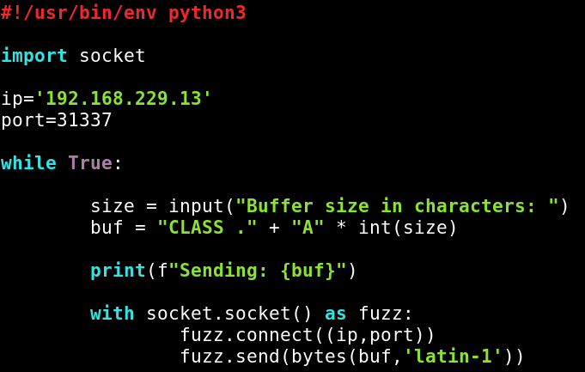
Exercise: Simple Fuzzer (Solutions)
Create a simple script in Python that can send larger amounts of data to the socket identified.
There are infinite ways to accomplish this. To the right is a screenshot of one way to do it in Python:
This script opens a simple socket, and sends the “buf” variable. BUF can be manually created, or user inputted as in the screenshot.
Notes:
Exercise: Simple Fuzzer (Solutions)
Create a simple script in Python that can send larger amounts of data to the socket identified.
There are infinite ways to accomplish this. To the right is a screenshot of one way to do it in Python:
This script opens a simple socket, and sends the “buf” variable. BUF can be manually created, or user inputted as in the screenshot.

Slide 47
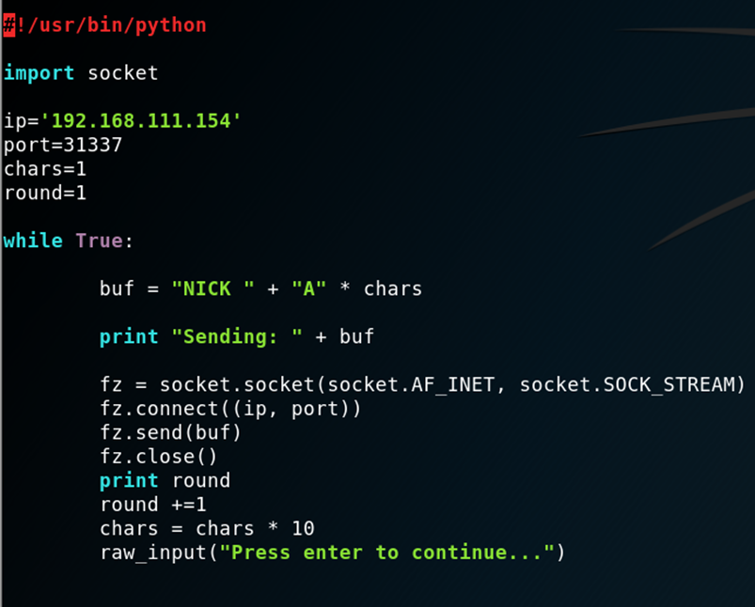
Exercise: Simple Fuzzer (Solutions)
CHALLENGE: The previous steps were all covered in the presentation. Now, you must build a Python script that will systematically increase the number of characters sent to a command until the application crashes (i.e., It will send NICK AAAAA then AAAAAAAAA etc.). When the program crashes, you must be able to identify this. Also, note that the “NICK” command is just one of several vulnerable commands.
(See screenshot at right)
Simple, and easily customizable, script for increasing number each round. The “Press enter to continue…” is not suitable for large scale fuzzing but helps the student see what each round is doing, and whether or not it has crashed.
Notes:
Exercise: Simple Fuzzer (Solutions)
CHALLENGE: The previous steps were all covered in the presentation. Now, you must build a Python script that will systematically increase the number of characters sent to a command until the application crashes (i.e., It will send NICK AAAAA then AAAAAAAAA etc.). When the program crashes, you must be able to identify this. Also, note that the “NICK” command is just one of several vulnerable commands.
(See screenshot at right)
Simple, and easily customizable, script for increasing number each round. The “Press enter to continue…” is not suitable for large scale fuzzing but helps the student see what each round is doing, and whether or not it has crashed.

Slide 48
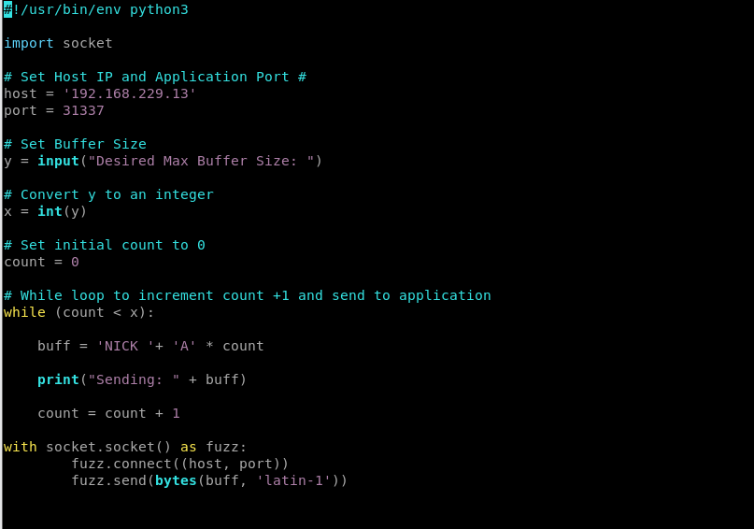
Exercise: Simple Fuzzer (Solutions)
The following is an alternate solution for Step# 5
Notes:
Exercise: Simple Fuzzer (Solutions)
CHALLENGE: The previous steps were all covered in the presentation. Now, you must build a Python script that will systematically increase the number of characters sent to a command until the application crashes (i.e., It will send NICK AAAAA then AAAAAAAAA etc.). When the program crashes, you must be able to identify this. Also, note that the “NICK” command is just one of several vulnerable commands.
(See screenshot at right)
Simple, and easily customizable, script for increasing number each round. The “Press enter to continue…” is not suitable for large scale fuzzing but helps the student see what each round is doing, and whether or not it has crashed.

Slide 49

Debrief
General Questions
How did you feel about this procedure?
Were there any areas in particular where you had difficulty?
Do you understand how this relates to the work you will be doing?
Specific Questions
Were you able to “manually fuzz” any of the commands?
If yes, what techniques did you use?
What increment did your fuzzer count by in the CHALLENGE?
Which commands did you try?
Notes:
Instructor Notes:
Provide a short debrief on the exercise, allowing students to think more about what they’ve practiced, and answer any related questions that they might have on the procedure/topic.
The questions here have no real answers. They are just used to start a dialogue between students and instructors, or students and other students. Time permitting, you should allow some discussion/debate about what to include that improves the efficiency and/or quality of the script.
Key Concept and Interactivity:
n/a
Reference Material:
n/a

Slide 50
Exercise: SPIKE
Objectives
After completing this exercise, students will be able to:
Use a third-party fuzzer to test an application
Duration
This exercise will take approximately 1 hours to complete.
EX
1 -------
2 -------
3 -------
Notes:
Instructor Notes:
Approximate exercise duration: 1 hour.
Exercise description:
In this exercise students will practice identifying buffer overflow vulnerabilities in an unknown application utilizing SPIKE.
Key Concept and Interactivity:
n/a
Reference Material:
n/a

Slide 51
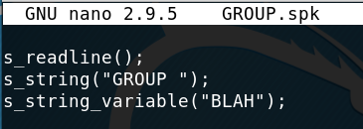
Exercise: SPIKE (Solutions)
Create a SPIKE script (.spk file) that will test the GROUP command.
Configure the SPK file with the following details:
The s_string_variable can be anything. We taught the students to use “COMMAND” earlier in the course.
Notes:
Exercise: SPIKE (Solutions)
Create a SPIKE script (.spk file) that will test the GROUP command
Configure the SPK file with the following details:
s_readline();
s_string(“GROUP ");
S_string_variable("BLAH");
The s_string_variable can be anything. We taught the students to use “COMMAND” earlier in the course.

Slide 52
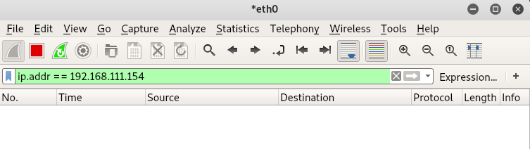
Exercise: SPIKE (Solutions)
Configure Wireshark to monitor the SPIKE fuzzer’s traffic.
HINT: This is one of the easier ways to identify the string that caused the crash. Be careful, since there are many streams that will include failed fuzz attempts. Remember, the Extended Instruction Pointer (EIP) will generally show the string of letters (or hex) that crashed the program. So, if you find “ABCD” in the EIP, that’s what you should search for in your PCAP.
Start Wireshark, set it to begin capture, and you can apply a filter (either capture or view) if you want to cut down noise. I’d recommend a view filter for your target IP:
Notes:
Exercise: SPIKE (Solutions)
Configure Wireshark to monitor the SPIKE fuzzer’s traffic.
HINT: This is one of the easier ways to identify the string that caused the crash. Be careful, since there are many streams that will include failed fuzz attempts. Remember, the Extended Instruction Pointer (EIP) will generally show the string of letters (or hex) that crashed the program. So, if you find “ABCD” in the EIP, that’s what you should search for in your PCAP.
Start Wireshark, set it to begin capture, and you can apply a filter (either capture or view) if you want to cut down noise. I’d recommend a view filter for your target IP: (see screenshot).

Slide 53
Exercise: SPIKE (Solutions)
Run the fuzzer against the Character Server.
Notes:
Exercise: SPIKE (Solutions)
Run the fuzzer against the Character Server.
/usr/bin/generic_send_tcp 192.158.111.154 31337 GROUP.spk 0 0

Slide 54
Debrief
General Questions
How did you feel about this procedure?
Were there any areas in particular where you had difficulty?
Do you understand how this relates to the work you will be doing?
Specific Questions
Did a crash occur?
If yes, what techniques/scripts did you use?
Did you capture the string that crashed the command?
What was the exact string?
Notes:
Instructor Notes:
Provide a short debrief on the exercise, allowing students to think more about what they’ve practiced and answering any related questions that they might have on the procedure/topic.
Key Concept and Interactivity:
n/a
Reference Material:
n/a

Slide 55
Debrief Solutions
Did a crash occur?
If yes, what techniques/scripts did you use?
The crash occurs very quickly, within a couple of seconds. So, while students may have to do some trial and error, the goal is to stop the fuzzer as fast as possible after a crash.
Notes:
Instructor Notes:
Provide a short debrief on the exercise, allowing students to think more about what they’ve practiced and answering any related questions that they might have on the procedure/topic.
Guidance for specific discussion questions:
Did a crash occur? If yes, what techniques/scripts did you use?
The crash occurs very quickly, within a couple of seconds. So, while students may have to do some trial and error, the goal is to stop the fuzzer as fast as possible after a crash.
Did you capture the string that crashed the command? What was the exact string?
Key Concept and Interactivity:
n/a
Reference Material:
n/a

Slide 56
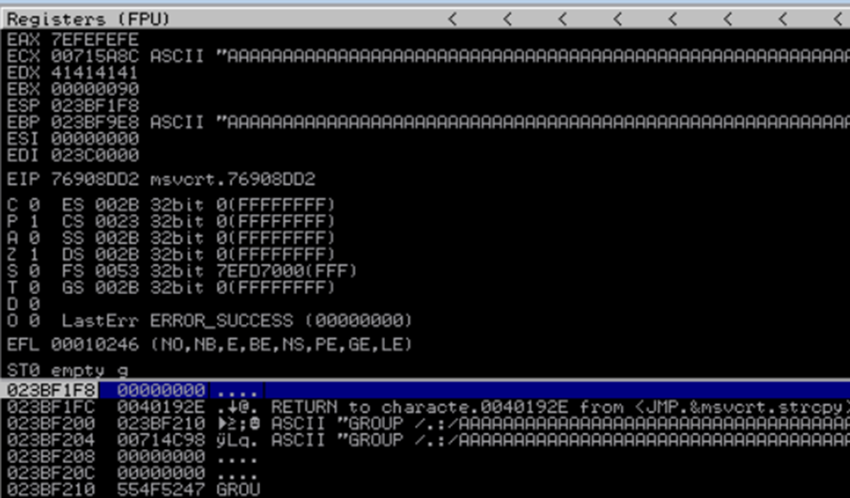
Debrief Solutions
Did you capture the string that crashed the command?
What was the exact string?
Once we have identified a crash, we need to try to find the string that caused it. Instructors please note, it is possible that different strings cause the crash. There is no wrong answer here if you find a crash. Here is a crash that could be consistently duplicated for GROUP. To find this string there are multiple steps we need to do:
First, identify what string is in memory: (see screenshot at right)
Note, that this starts with “GROUP /.:/” followed by a bunch of “A’s”
Notes:
Instructor Notes:
Provide a short debrief on the exercise, allowing students to think more about what they’ve practiced and answering any related questions that they might have on the procedure/topic.
Guidance for specific discussion questions:
Did a crash occur? If yes, what techniques/scripts did you use?
The crash occurs very quickly, within a couple of seconds. So, while students may have to do some trial and error, the goal is to stop the fuzzer as fast as possible after a crash.
Did you capture the string that crashed the command? What was the exact string?
Key Concept and Interactivity:
n/a
Reference Material:
n/a

Slide 57
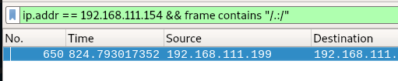
Debrief Solutions
Did you capture the string that crashed the command?
What was the exact string?
Now, let’s find that in Wireshark: (see screenshot below)
If you dissect this packet you’ll see the full string starting with GROUP /.:/AAA… This string can be copied by right clicking on the packet and following the TCP stream.
Notes:
Instructor Notes:
Did you capture the string that crashed the command? What was the exact string?
Now, let’s find that in Wireshark: (see screenshot in slide)
If you dissect this packet you’ll see the full string starting with GROUP /.:/AAA… This string can be copied by right clicking on the packet and following TCP stream.
Key Concept and Interactivity:
n/a
Reference Material:
n/a

Slide 58
Exercise: Intermediate Fuzzer (BONUS)
Objectives
After completing this exercise, students will be able to:
Perform manual fuzzing
Develop fuzzing scripts
Determine potential vulnerabilities
Duration
This exercise will take approximately 5 hours to complete.
EX
1 -------
2 -------
3 -------
Notes:
Instructor Notes:
Approximate exercise duration: 5 hours.
Exercise description:
In this exercise students will practice identifying buffer overflow vulnerabilities in an unknown application. Techniques used will be “manual” fuzzing, simple socket fuzzing, and creating Python scripts to assist fuzzing.
NOTE: This one is optional and is here for students that finish the first two exercises and have spare time.
Key Concept and Interactivity:
…
Reference Material:
…

Slide 59
Exercise: Intermediate Fuzzer (Solutions)
This exercise directs the students to challenge themselves and improve their simple fuzzer by adding functionality. Unfortunately, there are just far too many (READ: infinite) options that a student may add. Because of this, instead of adding a single answer (the script), there are examples and ideas for each of the features discussed in the directions section.
Automatic Crash Detection Ideas
One of the features that can make fuzzers more functional is the addition of crash/freeze detection. In instances where possible, the script can detect the remote server has stopped functioning and stop sending additional fuzzing iterations. This can be easier to accomplish when integrating with debuggers, as they can report back to your script directly. But for our purposes, we can try to detect crash like behavior.
You could try to detect if the socket goes down by integrating the following code, sourced from: https://stackoverflow.com/questions/17386487/python-detect-when-a-socket-disconnects-for-any-reason
Notes:
Exercise: Intermediate Fuzzer (Solutions)
This exercise directs the students to challenge themselves and improve their simple fuzzer by adding functionality. Unfortunately, there are just far too many (READ: infinite) options that a student may add. Because of this, instead of adding a single answer (the script), there are examples and ideas for each of the features discussed in the directions section.
Automatic Crash Detection Ideas
One of the features that can make fuzzers more functional is the addition of crash/freeze detection. In instances where possible, the script can detect the remote server has stopped functioning and stop sending additional fuzzing iterations. This can be easier to accomplish when integrating with debuggers, as they can report back to your script directly. But for our purposes, we can try to detect crash like behavior.
You could try to detect if the socket goes down by integrating the following code, sourced from: https://stackoverflow.com/questions/17386487/python-detect-when-a-socket-disconnects-for-any-reason

Slide 60
Exercise: Intermediate Fuzzer (Solutions)
Automatic Crash Detection Ideas (continued)
import select
import socket
ip = '127.0.0.1'
port = 80
conn = socket.socket(socket.AF_INET, socket.SOCK_STREAM)
conn.connect((ip, port))
while True:
try:
ready_to_read, ready_to_write, in_error = \
select.select([conn,], [conn,], [], 5)
except select.error:
conn.shutdown(2) # 0 = done receiving, 1 = done sending, 2 = both
conn.close()
# connection error event here, maybe reconnect
print 'connection error'
break
if len(ready_to_read) > 0:
recv = conn.recv(2048)
# do stuff with received data
print 'received:', recv
if len(ready_to_write) > 0:
# connection established, send some stuff
conn.send('some stuff')
Notes:
Exercise: Intermediate Fuzzer (Solutions)
Automatic Crash Detection Ideas (continued)
import select
import socket
ip = '127.0.0.1'
port = 80
conn = socket.socket(socket.AF_INET, socket.SOCK_STREAM)
conn.connect((ip, port))
while True:
try:
ready_to_read, ready_to_write, in_error = \
select.select([conn,], [conn,], [], 5)
except select.error:
conn.shutdown(2) # 0 = done receiving, 1 = done sending, 2 = both
conn.close()
# connection error event here, maybe reconnect
print 'connection error'
break
if len(ready_to_read) > 0:
recv = conn.recv(2048)
# do stuff with received data
print 'received:', recv
if len(ready_to_write) > 0:
# connection established, send some stuff
conn.send('some stuff’)
(Sourced from: https://stackoverflow.com/questions/17386487/python-detect-when-a-socket-disconnects-for-any-reason)

Slide 61
Exercise: Intermediate Fuzzer (Solutions)
Variable commands for future use
This one is a bit easier to accomplish. We can do this by adding an input() or raw_input() for commands. For example:
command=raw_input(“What command do you wish to fuzz: “) buf = command + “ “ + char * size
Automate the ability to identify commands, fuzz them, report back…
This is a far more tedious challenge. To do this, you’ll have to first identify a good way of detecting a crash (socket timeout or similar) and then add a loop to iterate through reading the menu, picking a command, and fuzzing that command. To fully automate this would likely take longer than we have in the classroom. A solid goal would be to first manually inspect the menu, and then program the fuzzer in a loop including the two challenges listed above, with the addition of a loop that iterates the commands (upon socket failure of the current command or a timeout after a specific number of fuzzing attempts).
Notes:
Exercise: Intermediate Fuzzer (Solutions)
Variable commands for future use
This one is a bit easier to accomplish. We can do this by adding an input() or raw_input() for commands. For example:
command=raw_input(“What command do you wish to fuzz: “) buf = command + “ “ + char * size
Automate the ability to identify commands, fuzz them, report back…
This is a far more tedious challenge. To do this, you’ll have to first identify a good way of detecting a crash (socket timeout or similar) and then add a loop to iterate through reading the menu, picking a command, and fuzzing that command. To fully automate this would likely take longer than we have in the classroom. A solid goal would be to first manually inspect the menu, and then program the fuzzer in a loop including the two challenges listed above, with the addition of a loop that iterates the commands (upon socket failure of the current command or a timeout after a specific number of fuzzing attempts).

Slide 62
Exercise: Intermediate Fuzzer (Solutions)
Allow for use of custom strings generated 3rd part software or sources
This is an incredibly easy part of the challenge. There are two simple ways of accomplishing this.
Cut and paste into user input. Create a raw_input() or input() for a custom buffer string:
bufstring=raw_input(“Input custom string here: “)
Read from a file.
with open(‘somefile.txt’, ‘r’) as stringfile:
bufstring=stringfile.read().replace(‘\n’, ‘’)
Notes:
Exercise: Intermediate Fuzzer (Solutions)
Allow for use of custom strings generated 3rd part software or sources
This is an incredibly easy part of the challenge. There are two simple ways of accomplishing this.
Cut and paste into user input. Create a raw_input() or input() for a custom buffer string:
bufstring=raw_input(“Input custom string here: “)
Read from a file.
with open(‘somefile.txt’, ‘r’) as stringfile:
bufstring=stringfile.read().replace(‘\n’, ‘’)

Slide 63
Debrief
Specific Questions
Were you able to “manually fuzz” any of the commands?
What increment did your fuzzer count by in the challenge?
Did a crash occur?
Did you capture the string that crashed the command?
Notes:
Instructor Notes:
1. Were you able to “manually fuzz” any of the commands?
All of them are fuzzable, but a simple one is CLASS which can be fuzzed with 2000 A’s. Seems like a lot for “manual” but not impossible. Copy and paste a series of 100 A’s can get to thousands very quickly.
2. What increment did your fuzzer count by in the challenge?
Students could do anything they want here. I picked 100 because I knew the overflow was relatively small. If students believed it was bigger they could have increased this number greatly.
3. Did a crash occur?
Yes. A SPIKE script that utilized s_readline(); and s_string(“GROUP “); and s_string_variable(“ANYTHING”);
4. Did you capture the string that crashed the command?
Yes. You capture it either in memory or in wireshark. It should have been “GROUP /.:/” followed by a couple thousand A’s. It’s also possible the beginning would be “GROUP /…/”
Key Concept and Interactivity:
n/a
Reference Material:
n/a

Slide 64
Lesson Summary
In this lesson we learned about:
Overflowing buffers
Manually
Simple Python scripts
Fuzzers
Developing your own fuzzer
Create your own simple network fuzzer with Python
Improve functionality and flexibility of your fuzzer
Prep before conducting buffer overflow exploits
Notes:
Instructor Notes:
In this lesson we discussed how to overflow buffers on simple, and vulnerable, network services/applications. We then take that knowledge and expand upon that by creating fuzzers in Python. We start off with simple scripts, move on to a simple fuzzer, and possibly a more flexible fuzzer.
Key Concept and Interactivity:
n/a
Reference Material:
n/a

Slide 65
End of Module 2, Lesson 13

